Slide 1
Mechanical Power Transmission
MMET 301
Syed Samar Abbas

Slide 2
Lubrication
Lubrication is the process of applying a substance (known as a lubricant) between two surfaces in relative motion to reduce friction, wear, and heat generated by their contact.
We know friction and consequent heat generation.
What is wear?
Wear refers to the gradual removal, deformation, or degradation of material from the surface of a solid body due to mechanical action such as friction, contact, or abrasion with another surface.
Material Loss: Wear results in removal of material from a surface, causing dimensional changes.
Surface Damage: Wear can cause roughening, scratching, or pitting of surfaces, which may lead to further damage.

Slide 3
Wear
Types/Mechanisms of Wear:
Abrasive Wear: Caused by hard particles or rough surfaces scraping against a softer surface, like sandpaper on wood.
Adhesive Wear: Occurs when two surfaces in contact bond and material transfers from one to the other, often due to friction (like metal galling).
Erosive Wear: Happens when particles or fluids impact a surface at high velocity, gradually eroding it (like sand eroding a rock).
Corrosive Wear: Due to chemical reactions, such as oxidation, that weaken or corrode the surface layer of a material.
Fatigue Wear: Resulting from cyclic stresses that cause surface material to crack and eventually wear away.

Slide 4
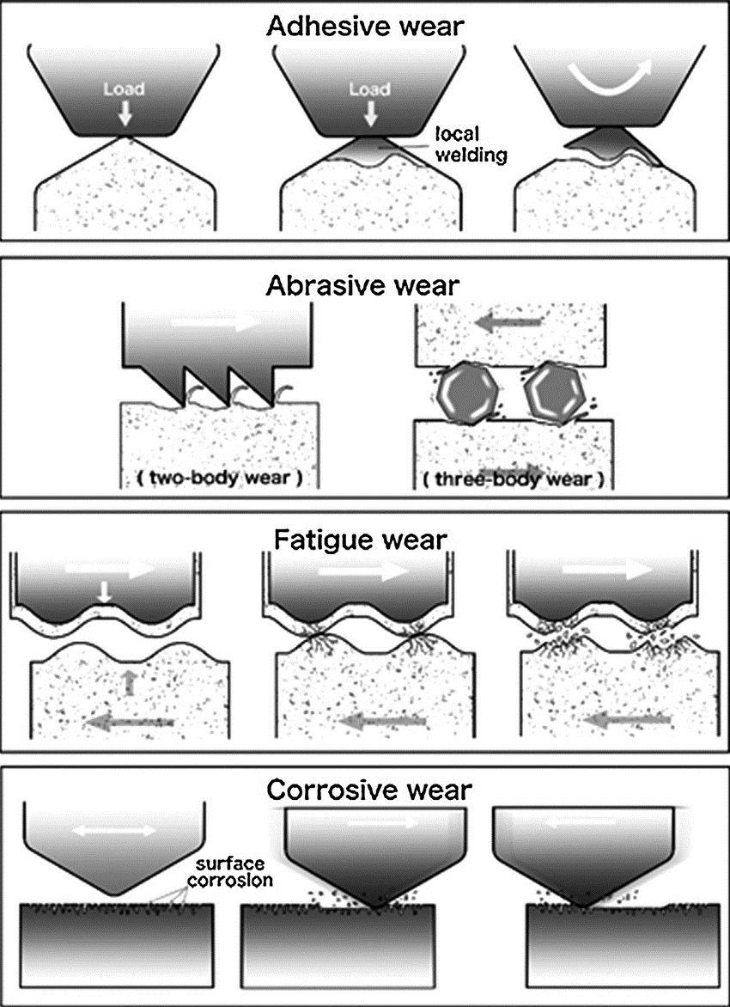
Types of Wear

Slide 5
Lubricant
Characteristics of lubricant:
Must have the proper viscosity
Good lubricity
Chemical stability
Compatibility with system materials
Fire resistant if possible
Good heat transfer capability
Low Density
Non-toxic
Low volatility
Definition of Viscosity: it’s the measure of the flowing ability of an oil. It is a property of an oil to develop and maintain a certain amount of shearing stress dependent on flow and to offer continued resistance as well.
- Your engine in your car has what type of viscosity when its cold?
- Your engine in your car has what type of viscosity when its hot?

Slide 6
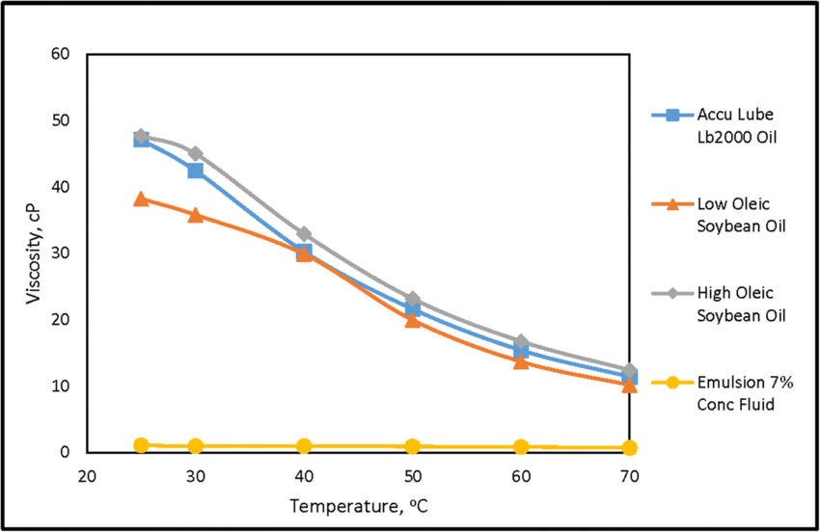
Lubricant
Characteristics of lubricant - Viscosity:

Slide 7
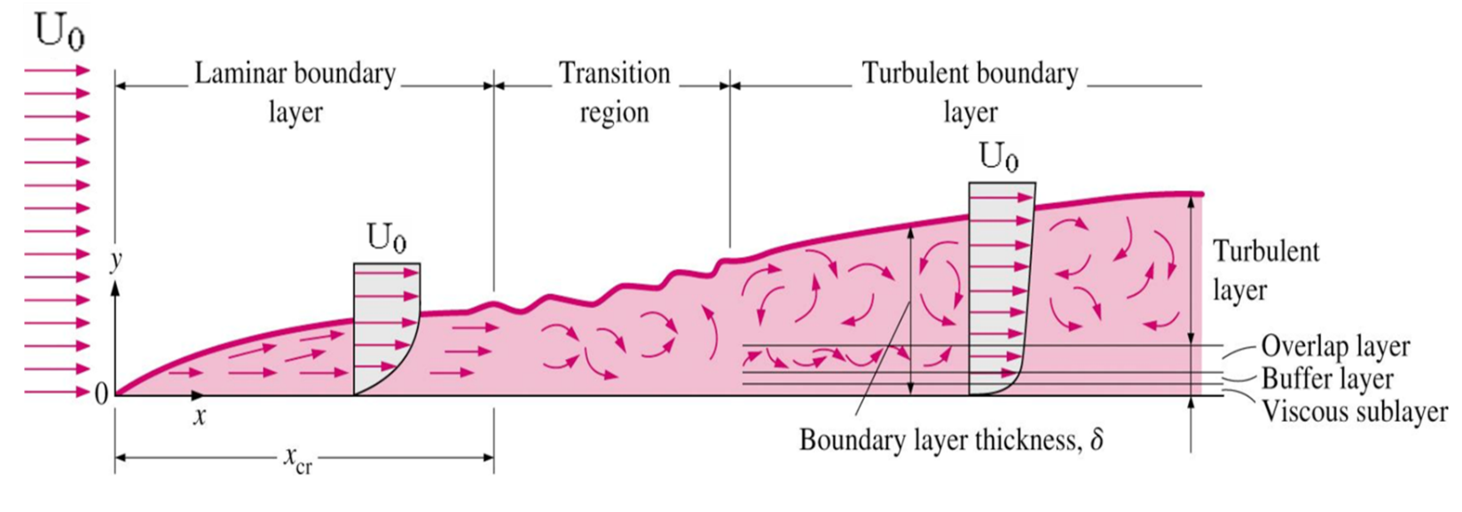
Lubricant
Characteristics of lubricant - Flow:
- Laminar Flow and Viscosity
* To get a good understanding for viscosity, we need to consider and remember laminar flow.
* If a fluid or gas is flowing over a surface, the molecules next to the surface (the ones clinging to the walls) have zero speed (granted the surface is stationary).
* As we get farther away from the surface, the speed increases.
* You can imagine that the amount of clinging-ness between the molecules will be proportional to the friction. This amount of clinging-ness is called viscosity.
* Thus, viscosity determines the amount of friction.

Slide 8
Lubricant
The viscosity should adapt to different engine temperatures, so manufacturers typically use multi-grade oils like 10W-30.
Cold Viscosity (W Rating): The first number in an oil's viscosity rating (e.g., the "10" in 10W-30) represents its flow characteristics at low temperatures, often referred to as the "W" (winter) rating. Lower "W" ratings allow the oil to flow more easily in cold conditions, reducing wear on engine components during startup.
High-Temperature Viscosity: The second number in an oil’s viscosity rating (e.g., the "30" in 10W-30) indicates how well the oil maintains its thickness and protective qualities at operating temperatures.

Slide 9
Lubricant
Types of lubrication systems:
Manual lubrication (Type A) : it consists of shutting down and physically applying lubricant. Moderate to low speeds.
Constant lubrication (Type B): it consists of operation in a shallow pool or bath, splashing disk or brush. Moderate to high speeds.
Pressurized or Pumped (Type C): it consists in forcing oil onto a mechanical device. High to very high speeds Manual – bearing is packed/etc. by hand or tool
Plating: Rolling element is soaked with a lubricant diluted in solution. The solution evaporates and the base lubricant is left behind, coating the component.

Slide 10
Lubrication Regimes
For now, imagine the following example:
Think of the rainwater on the road as the lubricant. Your tires and the road are the journal and the bearing.
Parked in the driveway, your tires are in full contact with the road. As you drive away, your tires still make good contact with the road. Representationally, the road and tires asperities are in contact and carrying the load of your car.
A few minutes later, while driving at highway speeds, you hit a puddle of water and begin to hydroplane. Your tires are no longer in contact with the road. The weight of your vehicle is lifted from the road by the water.
Ideally you would slow down once you start to hydroplane so your tires could regain contact with the road.

Slide 11
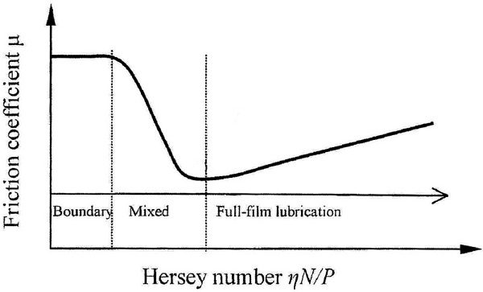
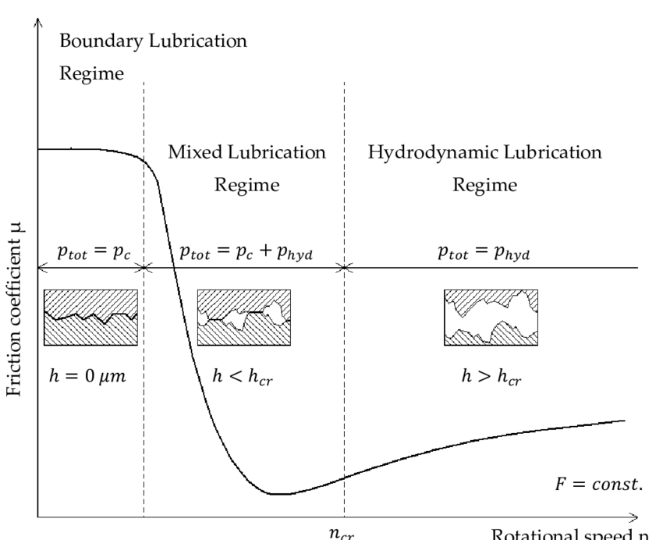
Lubrication Regimes
The Stribeck Curve

Slide 12
Lubrication Regimes
Boundary Lubrication:
The boundary lubrication regime starts when the journal begins to rotate from rest in the bearing, and the two, journal and bearing, are still in contact with each other.
Prior to journal rotation, static friction must be overcome. Static friction is higher than kinetic friction.
If the Stribeck curve graph starts at the “zero” mark along the x-axis, or where the rotational speed is zero, the coefficient of friction would be significantly higher than the lower and relatively flat curve of the boundary lubrication regime. Quite frequently this static friction is not shown on the Stribeck curve.

Slide 13
Lubrication Regimes
Boundary Lubrication (cont.):
Even though the journal and bearing appear to be highly polished surfaces, they contain asperities, or microscopic hills and valleys.
The full load is supported by microscopic peaks of the asperities.
In boundary lubrication, these asperities must slide over each other without lubrication film, as with pushing your couch across the floor, or with the assistance of the minimal amount of lubricant trapped in the asperity valleys.

Slide 14
Lubrication Regimes
Mixed Lubrication:
As the journal begins to rotate faster and faster, it drags the lubricant between itself and the bearing. This lubricant begins to lift the journal asperities off the bearing asperities reducing their contact and, thus, friction, as depicted in the mixed lubrication portion of the Stribeck curve.

Slide 15
Lubrication Regimes
Mixed Lubrication (cont.):
This portion of the Stribeck curve has the steepest slope where the coefficient of friction is significantly reduced over relatively small change in rotational speed as fewer and fewer asperities of the journal and bearing contact each other.
Note: In its simplest form, the Stribeck curve graphically shows how the coefficient of friction of a journal bearing is affected by the speed of the shaft rotation.

Slide 16
Lubrication Regimes
Hydrodynamic Lubrication:
The hydrodynamic lubrication regime is where the journal and bearing asperities no longer come in contact with each other and starts at the lowest coefficient of friction point of the Stribeck curve. It is also known as “full fluid film lubrication” because the load is carried entirely by the lubricant film.

Slide 17
Lubrication Regimes
Hydrodynamic Lubrication (cont.):
In the hydrodynamic lubrication regime, as the speed increases, the coefficient of friction begins to increase. It is the first time the coefficient of friction increases with increased speed, and it is due to the lubricant’s viscosity. Viscosity is a measure of the lubricant’s internal resistance to flow, thus with higher speeds the oil provides more resistance or friction.

Slide 18
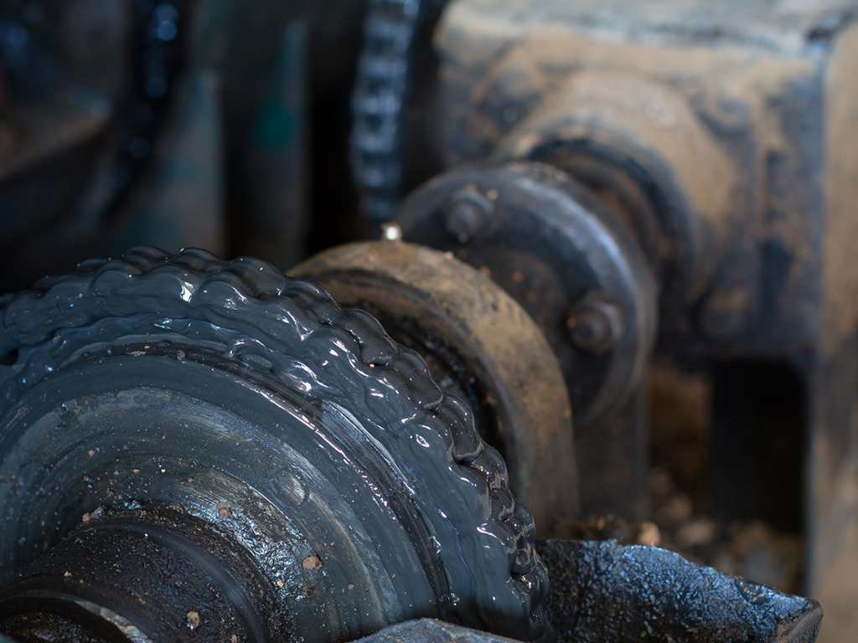
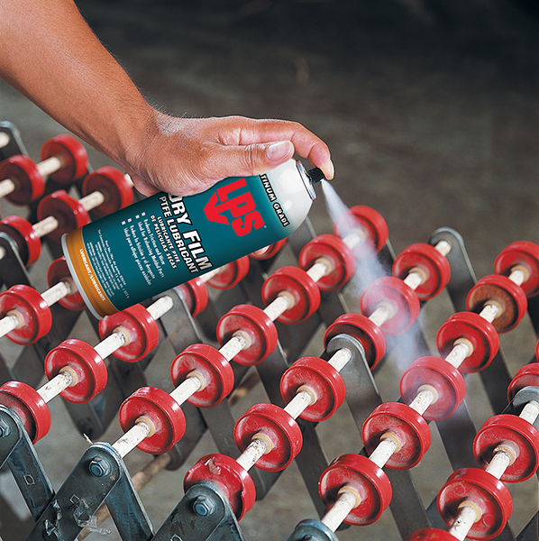
Solid lubricants
A wide variety of solid lubricants is also employed in the industry.
Used in solid-film lubricants.
Most used: Molybdenum Disulphide, Graphite and Polytetrafluoroethylene.
Properties to be considered: Co-efficient of friction, load carrying capacity and conductivity. Environment is also important!
Graphite Grease
PTFE

Slide 19
Solid lubricants
They could be used as:
Extreme Pressure (EP) or anti-wear additives:
Graphite finds applications as EP in pins and bushings.
Graphite has a layered structure with weak van der Waals forces between the layers, allowing them to slide over each other easily.
Under pressure, graphite forms a thin, low-friction layer on metal surfaces, which prevents direct metal-to-metal contact.
It can provide lubrication even under boundary lubrication conditions, where liquid films break down.
Molybdenum and Polytetrafluoroethylene (PTFE) are blended with engines oil and/or other lubricants.
Another, and probably most efficient use is the bonding or impregnation of these friction modifiers onto the surface of various machine components. For instance, cylinders liners or piston skirts.

