Slide 1
Mechanical Power Transmission
MMET 301
Syed Samar Abbas

Slide 2
Recapitulation: Bearings
A bearing is a device that enables smooth movement by reducing friction between moving parts, typically in machines with rotating or linear motion.
Bearings support rotating parts, such as shafts or axles, helping them move more easily while handling loads and minimizing wear and tear.
They are essential for improving efficiency, lifespan, and performance in any machine with moving parts.

Slide 3
Bearings
A bearing can restrict motion, but in a controlled and specific way. Bearings are designed to allow certain types of motion while limiting others based on the application's requirements.
They are engineered to allow movement in a specific direction (like rotation or linear sliding) while restricting movement in other directions.
Bearings also help dampen and restrict vibration and noise by reducing the amount of uncontrolled movement in the system.

Slide 4
Summary: Types of Bearings
Bearings
Rolling element
Ball bearing
Non-Rolling element
Plain bearing
Roller bearing

Slide 5
Types of Bearings
Bearings can be broadly classified into rolling and non-rolling (or plain) categories, based on their design and method of reducing friction.
Rolling bearings, also known as anti-friction bearings, use rolling elements (balls or rollers) between the bearing rings. The rolling elements allow for smoother motion with minimal friction.
Non-rolling or Plain bearings, also called friction or sleeve bearings, do not have rolling elements and instead rely on sliding motion. The shaft rotates or slides over a bearing surface, often lubricated to reduce friction.

Slide 6
Rolling Bearings
Rolling Element
Seal
Seal
Outer Raceway
Inner Raceway

Slide 7
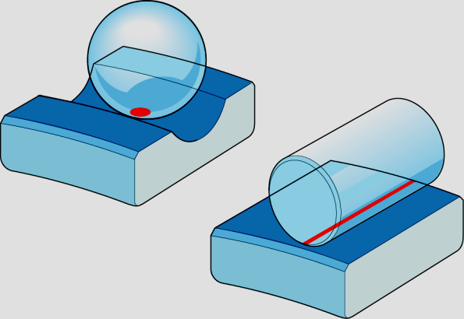
Types of Rolling Bearings
Ball Bearings:
Use spherical balls as rolling elements.
Suitable for moderate to high-speed applications with relatively low load capacities.
Examples: Deep Groove Ball Bearings, Angular Contact Ball Bearings, Thrust Ball Bearings.
Roller Bearings:
Use cylindrical, tapered, or spherical rollers as rolling elements.
Provide higher load capacities compared to ball bearings, but operate at lower speeds.

Slide 8
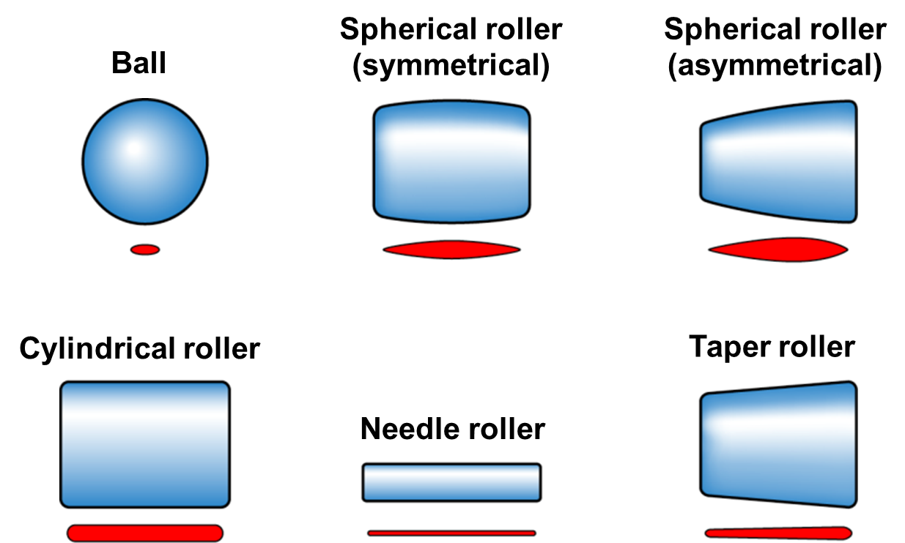
Rolling Bearings
Based on the type of rolling element
Contact

Slide 9
A few thoughts and questions
We discussed that ball bearings have a smaller area of contact between the balls and the raceways compared to roller bearings.
We also discussed that the ball bearings have lower load capacity than the roller bearings – consequence of contact area?
Low friction and high-speed applications?

Slide 10
Non-Rolling or Plain bearings
A plain bearing (also known as a sleeve bearing, bushing, or journal bearing) is a type of bearing that enables smooth, sliding motion between two surfaces by reducing friction without the use of rolling elements like balls or rollers.
Types of Plain Bearings:
Sleeve Bearings: Simple cylindrical shape that surrounds a rotating shaft.
Flanged Bearings: Cylindrical sleeve with an extended flange at one end, providing both radial and axial support.
Thrust Bearings: Flat, disc-shaped bearings designed to support axial loads.
Hydrodynamic and Hydrostatic Bearings

Slide 11
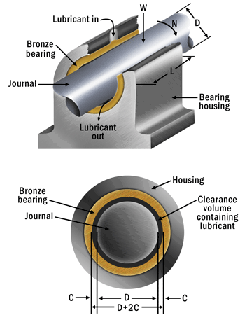
Non-Rolling or Plain bearings

Slide 12
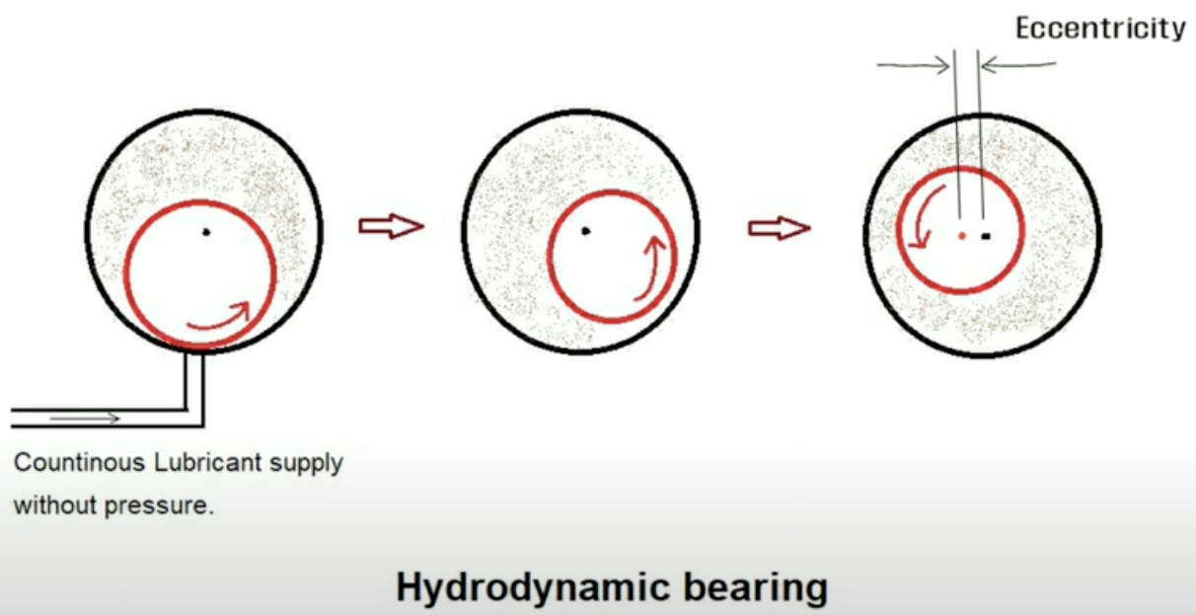
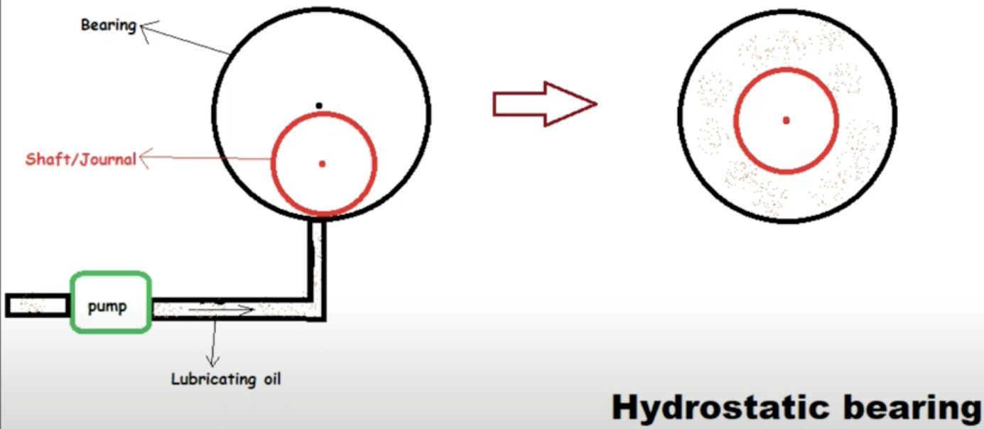
Non-Rolling or Plain bearings
Hydrodynamic and Hydrostatic Bearings
Feature | Hydrodynamic Bearings | Hydrostatic Bearings
Lubricant Film Formation | The lubricant film is formed dynamically by shaft’s rotation. | The lubricant film is supplied and pressurized externally by a pump.

Slide 13
Non-Rolling or Plain bearings
Key Characteristics of Plain Bearings:
Simple Design: Plain bearings are typically cylindrical or flanged sleeves that fit between the moving parts.
Low Friction with Lubrication: They use lubricants, such as oil or grease, to reduce friction, wear, and heat. Some are made of self-lubricating materials like bronze or certain polymers.
Low Cost and Compact: With a simpler construction compared to rolling-element bearings, plain bearings are more compact, affordable, and easier to manufacture.
Durable for High Load, Low-Speed Applications: They excel in situations with high loads and low speeds.

