Slide 1
Mechanical Power Transmission
MMET 301
Syed Samar Abbas

Slide 2
Couplings
Mechanisms of power transmission between shafts discussed so far:
Cutches and Brakes.
Belt drives.
Chains and sprockets.
Gears (with gearboxes).
Left with: Couplings, Universal and Bearings.
By definition: A coupling is a mechanical device that connects two rotating shafts (usually along the same axis), thereby allowing the transmission of power from one shaft to the other.
Essential for aligning the shafts (or keeping them aligned).
Accommodate small misalignments, absorb shocks and vibrations, ensuring and efficient and reliable power transfer between rotating equipment.
Sometimes used to lengthen the shafts with stability.

Slide 3
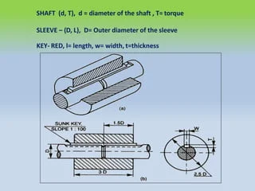
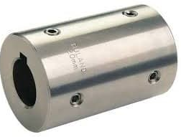
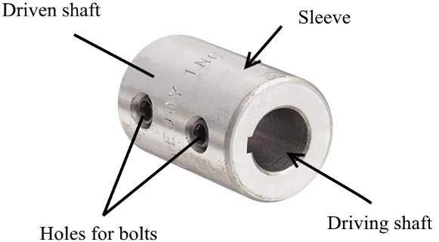
Types of Couplings
(A)
Rigid Coupling
Directly connects two shafts with no flexibility.
Used when shafts are perfectly aligned.
Examples:
Sleeve or Muff Coupling:
In a conveyor system with two perfectly aligned shafts, a sleeve coupling might be used to connect them. Here, a hollow cylindrical sleeve slides over the ends of both shafts and is fixed with set screws (or keys).

Slide 4
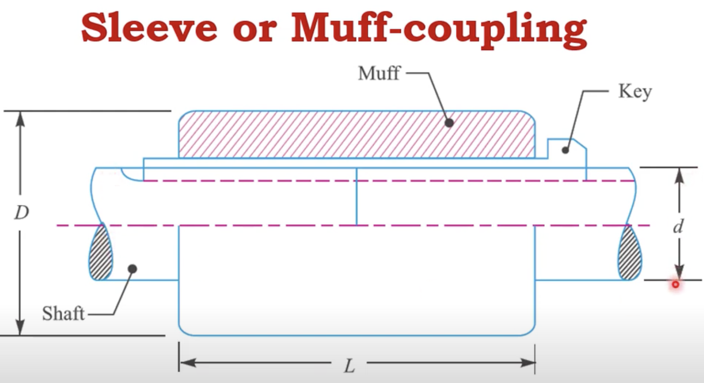
Types of Couplings
(A)
Rigid Coupling
Design considerations for Sleeve or Muff Coupling:
What do you think are the few parameters you need to consider?
The diameter of the shaft (d).
The dimensions of the sleeve (length - L and diameter - D).
The dimensions of the key (width and height/thickness).

Slide 5
Types of Couplings
(A)
Rigid Coupling
Design considerations for Sleeve or Muff Coupling:
Assume that the sleeve coupling must transmit 15 kW at a speed of 360 RPM from one shaft to another. The allowable shear stress for the shaft is 45 MPa.
Step 1 involves finding the torque.
Step 2 involves finding the shaft diameter (d, where T=pi*d³*stress/16).
Step 3 involves ‘estimating’ the sleeve diameter (D = 2d or 2d+13mm).
Step 4 involves ‘estimating’ the sleeve length (Total L = 3 or 3.5d generally).
Step 5 involves ‘estimating’ the dimensions of the key (w and h = 0.25d).

Slide 6
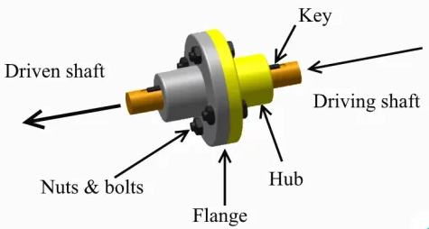
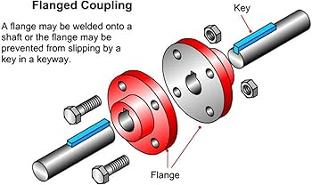
Types of Couplings
(A)
Rigid Coupling
Examples:
Flange Coupling: In marine propulsion, flange couplings are often used to connect the motor shaft with the ship’s propeller shaft. They constitute of flanges bolted together and provide high torque transmission.

Slide 7
Types of Couplings
(B)
Flexible Coupling
More versatile because they allow for a slight misalignment between shafts, which helps reduce wear and tear on connected components.
Types of misalignments: Angular, parallel or torsional (and others).
Examples:
Jaw coupling: They have two hubs with “jaws” and an elastomeric spider in between. The elastomer helps absorb shock and vibration, which is especially useful in pump systems where loads can vary due to fluid pressure changes.

Slide 8
Types of Couplings
(B)
Flexible Coupling
Examples:
Jaw coupling:
Again, what do you think should be the design principles? Assume a motor connected to a pump for power transmission.
Torque, power and RPMs.
Elastomer materials (for the spider, under particular operating conditions).
Coupling sizes (diameter of the coupling jaw).

Slide 9
Types of Couplings
(B)
Flexible Coupling
Examples:
Disc Coupling: In wind turbines, disc couplings are commonly used to connect the gearbox to the generator. They consist of thin, flexible metal discs that can handle angular, axial, and radial misalignment. Since wind turbines experience variable loads and slight shaft misalignments, disc couplings help ensure smooth power transmission even under fluctuating conditions.
Gear Coupling: Heavy machinery, such as steel rolling mills, often use gear couplings due to their ability to handle high torque and slight misalignments. Gear couplings use toothed hubs that mesh together, allowing some flexibility. This is important in steel mills where shaft alignments may shift due to thermal expansion and other operational stresses.

Slide 10
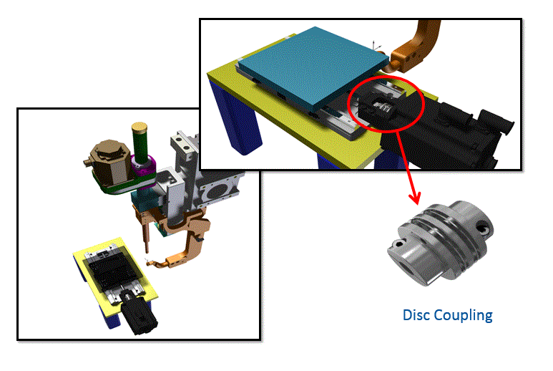
Types of Couplings
(B)
Flexible Coupling
Examples:
Disc Coupling:

Slide 11
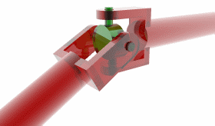
Universal
- A universal (often called a "universal joint" or "U-joint") is a joint
or coupling that connects two shafts, allowing them to transmit rotational power even when they are not perfectly aligned.
- Universal joints are essential for applications where shafts meet at an angle, allowing them to rotate freely and efficiently transfer power across varying angles.

Slide 12
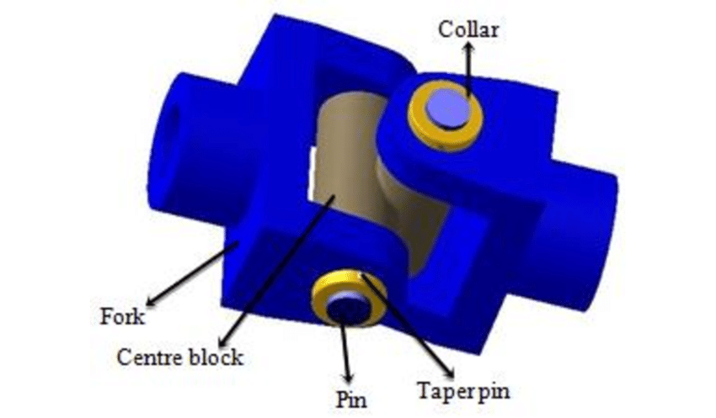
Universal
- Universal couplings allow shafts to connect at various angles,
up to 45 degrees. This flexibility is crucial for accommodating misalignment between shafts due to movement and/or vibration.
- Despite the angular connection, universal joints efficiently transmit torque from one shaft to the other, making them essential in systems with changing angles of rotation – be careful about load!

Slide 13
Numerical problem on Couplings
- A sleeve coupling connects two solid shafts in a motor and pump assembly. The following information is provided:
Power transmitted by the motor:
P=50kW
RPM (N)=1440RPM
Permissible shear stress for the shaft material: Τ_{shaft} =45 MPa
Permissible shear stress for the sleeve material: Τ_{sleeve} = 30 MPa
The diameter of the solid shaft (d).
The outer diameter (D) and length of the sleeve (L).
The dimensions of the key (width w and height h).

