Slide 1
Mechanical Power Transmission
MMET 301
Syed Samar Abbas

Slide 2
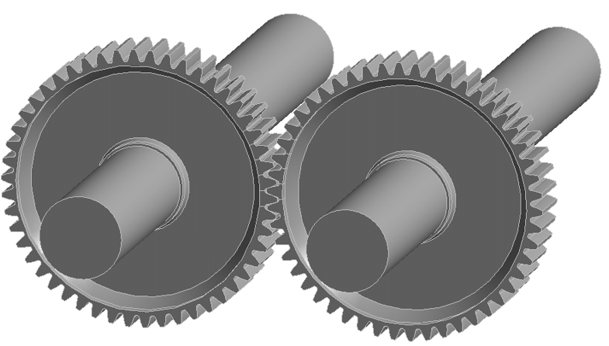
Introduction to Gears
By definition: Toothed wheels or cylinders that mesh together to:
Transmit motion;
or change the speed;
or change the direction of mechanical energy.
TYPES OF GEARS
Spur Gears
These have straight teeth and are mounted on parallel shafts.
They are efficient and commonly used for moderate-speed applications.
They tend to be noisy at high speeds.
Load only in the radial direction, no axial load.
Standard pressure angles are 14.5 and 20 degrees.

Slide 3
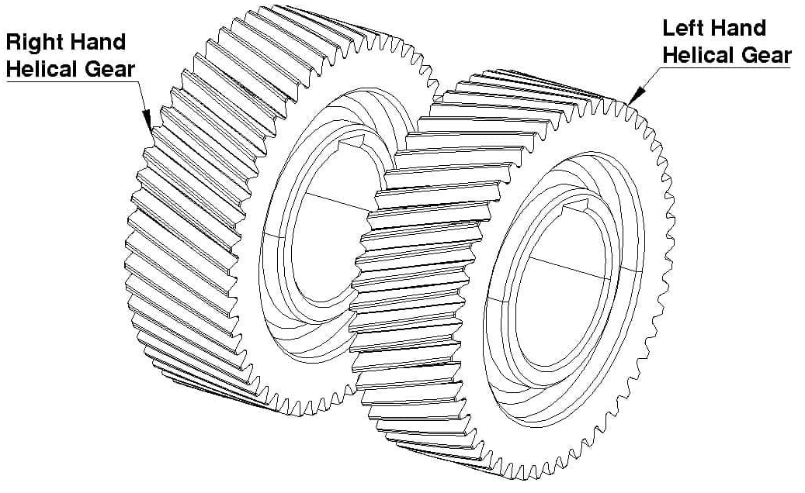
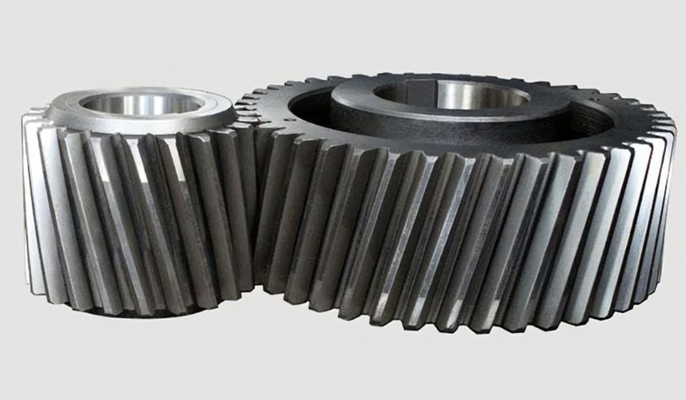
Introduction to Gears
TYPES OF GEARS
Helical Gears
These gears have teeth angled at a specific angle to the gear axis, creating a helix shape – helix angle ranges from 0 to 45 degrees.
They can transmit motion between parallel or perpendicular shafts.
Helical gears are quieter and can handle higher loads than spur gears due to gradual tooth engagement.

Slide 4
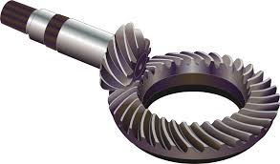
Introduction to Gears
TYPES OF GEARS
Bevel Gears
These gears have cone-shaped teeth and are used to change the axis of rotation.
Typically used for shafts intersecting at 90 degrees, but other angles are also possible.
Common in automotive applications.

Slide 5
Introduction to Gears
TYPES OF GEARS
Worm Gears
Consists of a worm (screw-like gear) and a worm wheel (gear).
The worm is typically the driver while the wheel is typically the driven gear.
Common in conveyors, elevators, and tuning mechanisms.

Slide 6
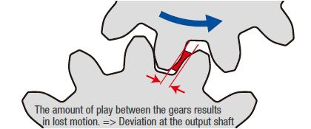
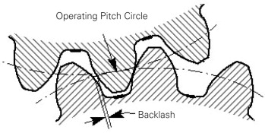
Introduction to Gears
Backlash
The amount of clearance between two mated gear teeth.
It is also defined as the amount of lost motion due to clearance or slackness when movement is reversed, and contact is re-established.
Pressure Angle
Also known as the angle of obliquity, it is the angle
between the tooth face and the gear wheel tangent.
Can we define it in terms of pitch circle?

Slide 7
Numerical Problem on Gears
A spur gear system consists of Gear A and Gear B, in mesh.
Gear A is the driving gear, and Gear B is the driven gear. The following information is provided:
Number of teeth on Gear A = 20
Number of teeth on Gear B = 50
Torque applied on Gear A = 30 Nm
Input speed of Gear A = 1200 rpm
Diametral pitch (P) of both gears = 5 teeth per inch
Assume no losses in power transmission.
a) Calculate the gear ratio between Gear A and Gear B.
b) Determine the rotational speed of Gear B.
c) Calculate the torque on Gear B.
d) Determine the power transmitted through the system.
e) Calculate the pitch diameters of Gear A and Gear B – Gear Ratio?

Slide 8
Numerical Problem on Gears
A spur gear system consists of Gear A and Gear B, in mesh.
Gear A is the driving gear, and Gear B is the driven gear. The following information is provided:
Number of teeth on Gear A = 20
Number of teeth on Gear B = 50
Torque applied on Gear A = 30 Nm
Input speed of Gear A = 1200 rpm
Diametral pitch (P) of both gears = 5 teeth per inch
Assume no losses in power transmission.
a) Let’s say that our assumption is wrong! What happens now?
b) Calculate the torque on Gear B if the efficiency is 92%.

Slide 9
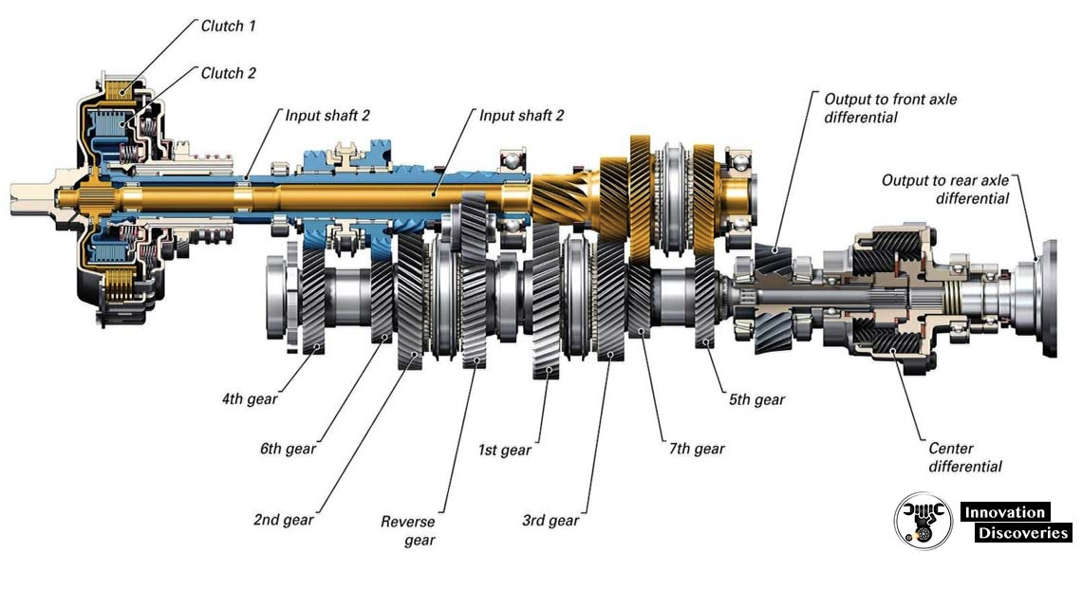
Gear Box
By definition: A gearbox is a mechanical device that uses a series of gears to transmit power from one component (such as an engine or motor) to another, while altering the torque and rotational speed, or changing the direction.

Slide 10
Numerical Problem on Gearbox
A car gearbox has the following gear ratios for different gears:
1st Gear Ratio = 3.5
2nd Gear Ratio = 2.0
3rd Gear Ratio = 1.2
4th Gear Ratio = 0.9
Differential (final drive) Gear Ratio = 4.0
The engine is running at 3000 rpm, and the car has tires with an effective diameter of 0.6 meters. Assume no slippage between the tires and the road.
Calculate the speed of the car (in m/s and km/h) when it is in:
a) 1st gear
b) 2nd gear
c) 4th gear

