Slide 1
Mechanical Power Transmission
MMET 301
Syed Samar Abbas

Slide 2
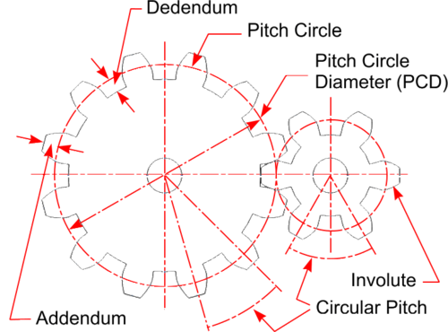
Recapitulation …
Pitch circle
An imaginary circle that intersects the teeth of a gear at the actual points where the teeth mesh with another gear.
Pitch
Distance between two identical points of adjacent cogs or teeth.
Dedendum
Depth of the tooth between the pitch circle and the minor dia.
Addendum
The height of the tooth above the pitch circle.

Slide 3
Chain drives
General definition
Chain drives transmit power from one sprocket to another via chains.
What is a sprocket?
- A sprocket is a toothed wheel or gear that engages with a chain, or other indented material to transmit rotary motion – Role of friction?
- Sprockets are commonly used in chain drives to transfer mechanical power between two rotating shafts or between a motor and a machine part, like in bicycles, motorcycles, and conveyor systems.
What is a chain?
- A chain is a series of linked, flexible components, often made of metal, designed to transmit mechanical power or move materials.

Slide 4
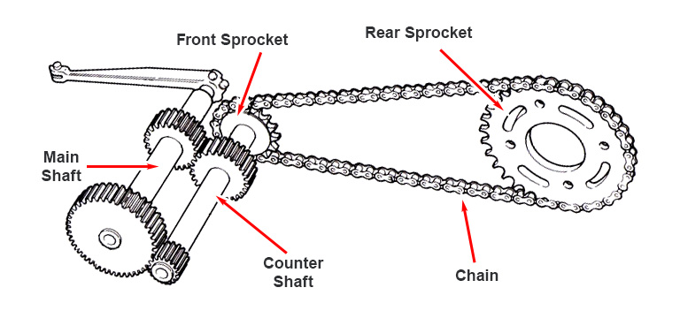
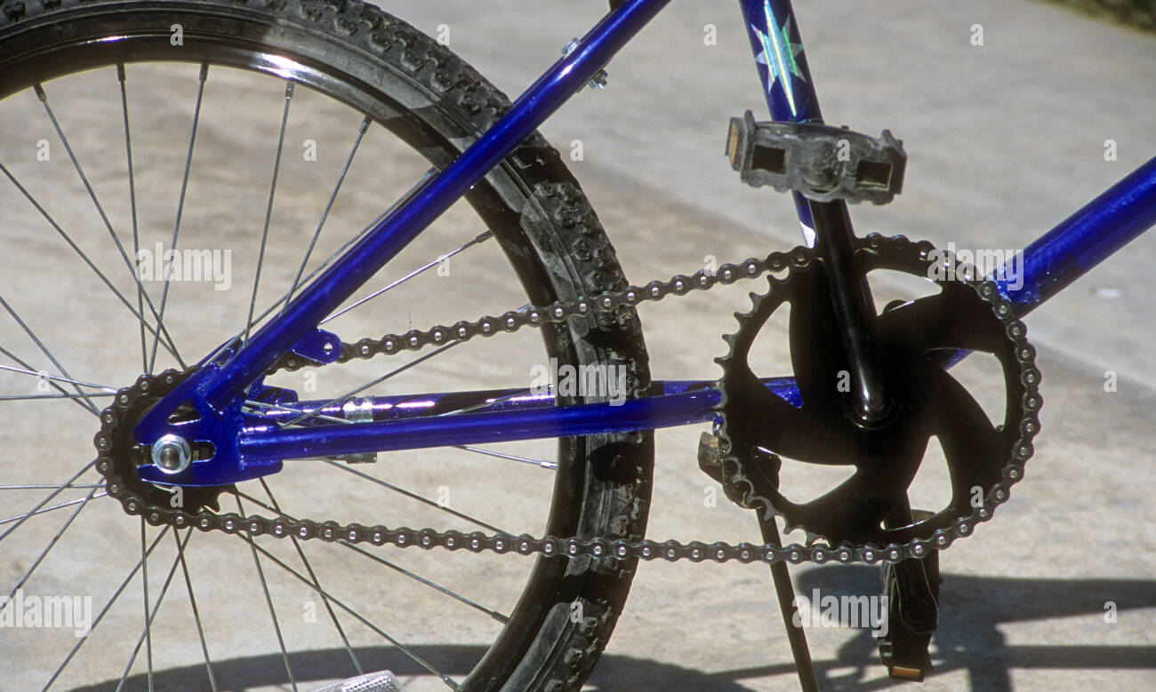
Chain drives

Slide 5
Chain drives
Chain drives operate in tension – similar to the belt drives.
The teeth on the driving sprocket engage and pull the chain links.
The other end of the chain links engage and pull the teeth on the driven sprocket.
Chain drives usually allow for higher speed ratios compared to the belt drives.
The efficacy of a belt drive system is heavily dependent on the contact between the belt and the pulley:
A substantial minimum arc of contact is required to avoid slippage.
A few sprocket teeth are required for an effective engagement for chain drives.

Slide 6
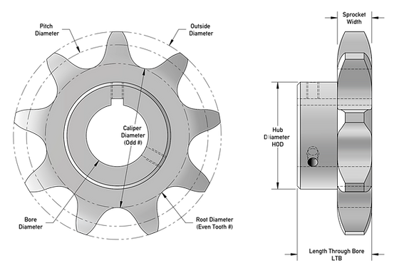
Chain drives – Sprockets
Main components:
Teeth: These engage with the chain
links to drive the chain and transmit power.
Pitch Diameter: The effective diameter of
the sprocket that determines the chain’s pitch
or the distance between links.
Hub: The central part that connects the
sprocket to the shaft, either directly or
via a keyway or bore.
Bore: The central hole that fits onto
a shaft, not necessarily a circle.
Front View
Side View

Slide 7
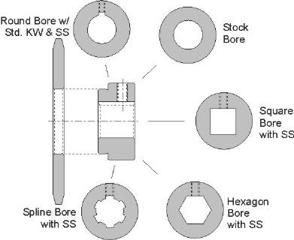
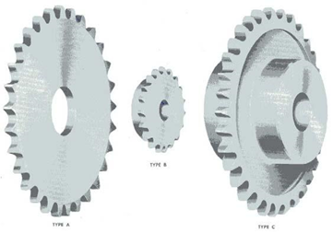
Chain drives - Sprockets
Type B: Hub on one side
Type A: No hub
Type C: Hub on both sides
Various types of sprockets:
Cast Iron, Machined metal, Steel plate, Plastics and Composite materials, etc.

Slide 8
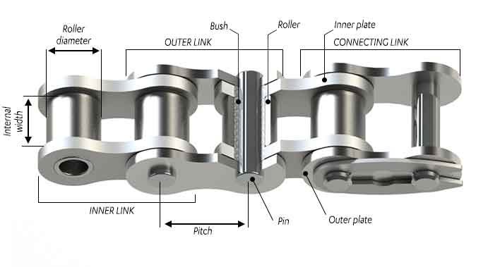
Chain drives - Chains
Main components:
Pin
Act as the point of pivot about which the roller or bush engages with the sprocket.
Bush
Roller
Free rolling element
Outer Link
Pin link
Inner Link
Roller link
Connector
Spring lock
Cotter pin
Pitch
Higher the pitch, higher the load capacity.
High pitch chains are loud and are not ideal for high-speed conditions.

Slide 9
Roller Chains
Contains pins that pivot inside the bushing – pin link (also called the outer link).
The roller surrounds bushing – roller link (also called an inner link).
An assembly of alternating pin links and roller links make a strand of a roller chain.
An ‘EVEN’ number of links are required to create a closed loop chain.

Slide 10
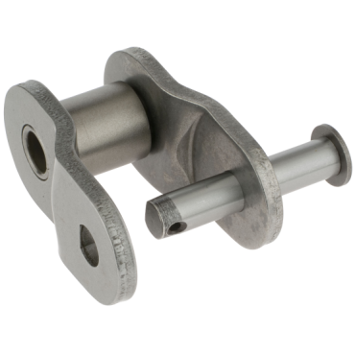
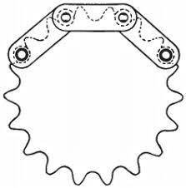
Chains Drives
Offset Chains: A type of roller chain that is specially designed to accommodate slight misalignments or variable distances between sprockets.
They have uneven number of links.
Can be used to connect odd number of chains.
Are primarily used to adjust chain length.
Double pitch chains: A type of roller chain where the pitch is doubled compared to standard roller chains.
They have fewer links for the same overall length, which results in fewer wear points and lower friction over longer distances.
Most used for conveyers.

Slide 11
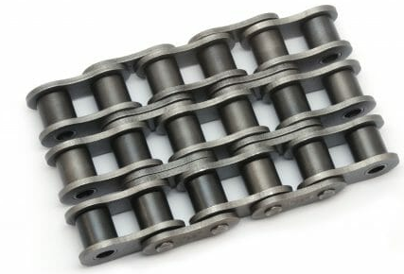
Chain Drives
Several types of chains and sprockets are available for a wide variety of:
Speed (may also reduce speed).
Torque (may provide with increased torque at the output shaft).
Operating conditions.
American National Standards Institute (ANSI) - publishes standards for chain drives.
Multiple-strand chains could also be used to transmit greater loads than the capacity of a single strand chain.

Slide 12
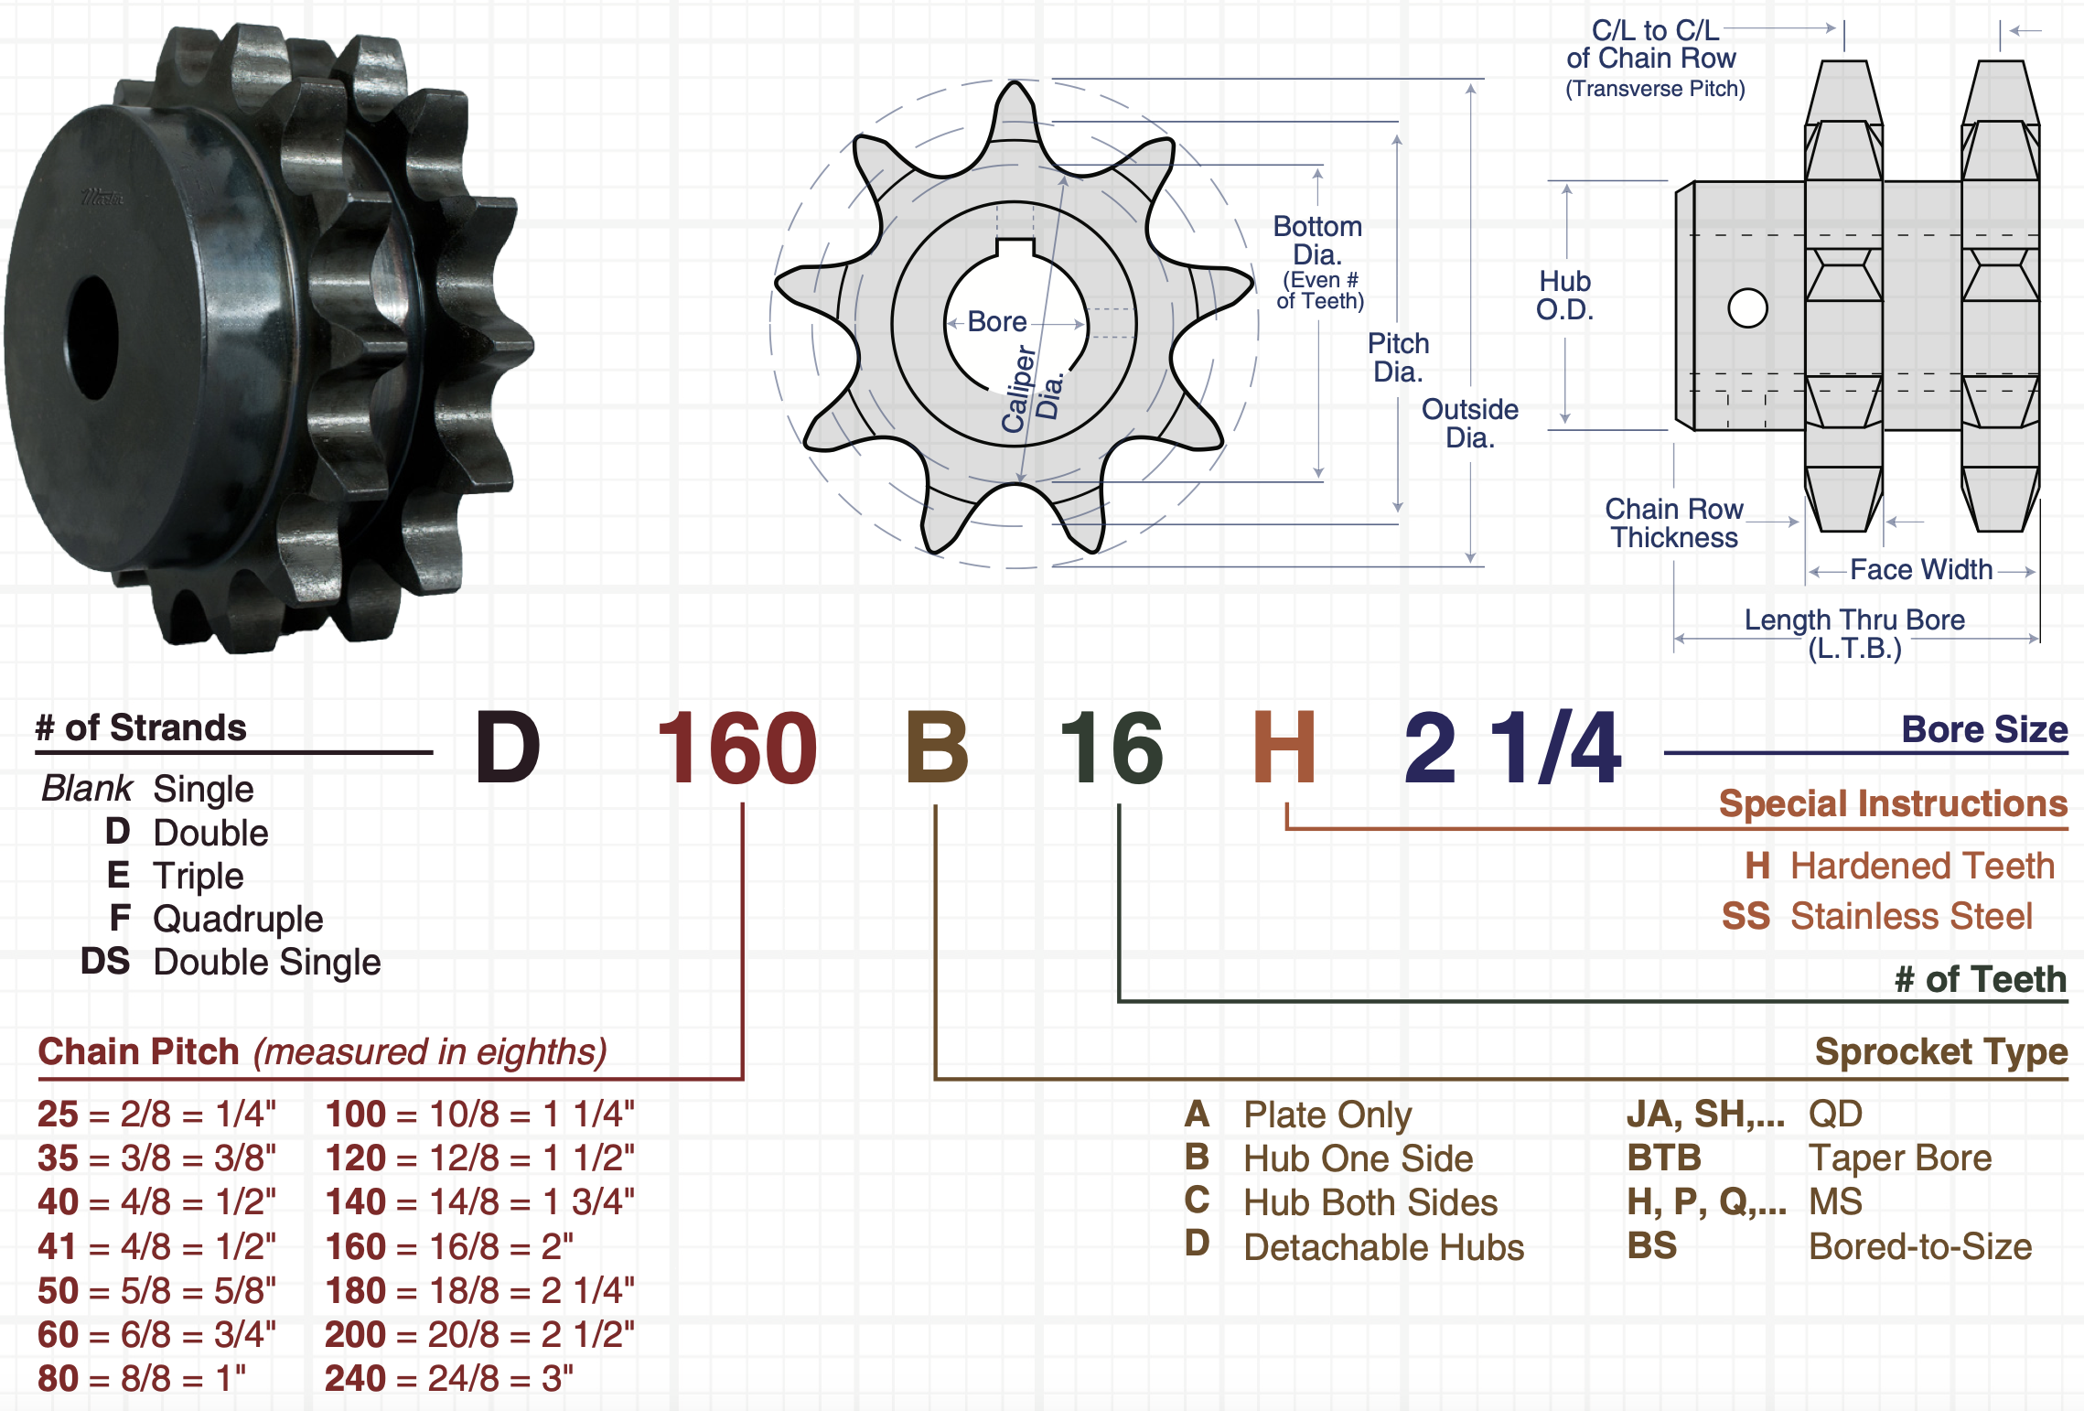
Nomenclature of Sprockets

Slide 13
Nomenclature of Chain drives
For chains only, ANSI nomenclature could only be two digits:
ANSI XY
X means the pitch is X/8 inches.
Y determines whether it is a normal chain (for Y=0), lightweight (for Y=1), rollerless bushed chain (for Y=5), etc.
For a double pitch chain, there will four digits:
ANSI 2040
Chain pitch = 2*(4/8) inches.
You might observe a letter H added after the number:
The suffix -H typically signifies that the chain has heavy roller links.

