Slide 1
Mechanical Power Transmission
MMET 301
Syed Samar Abbas

Slide 2
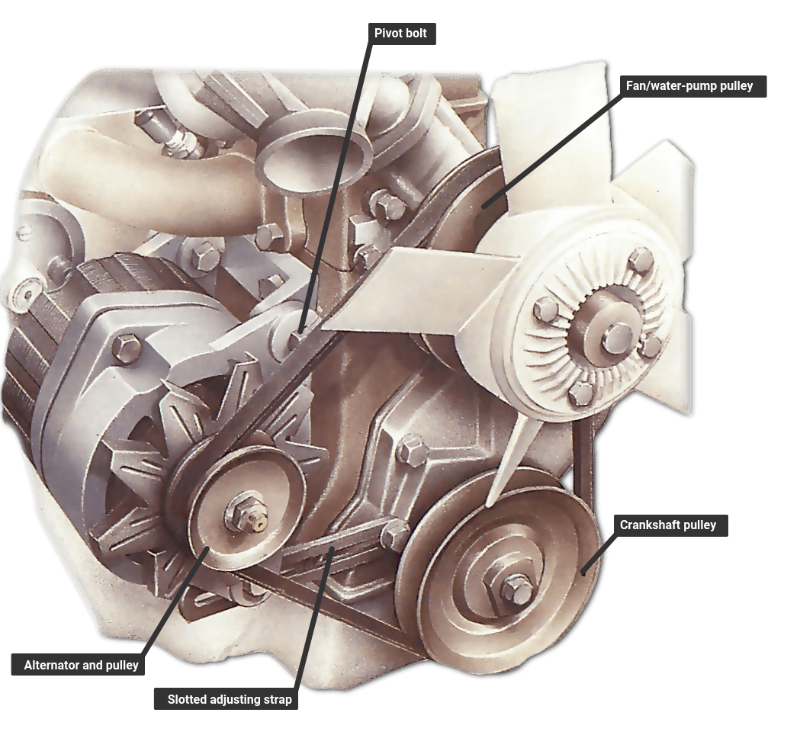
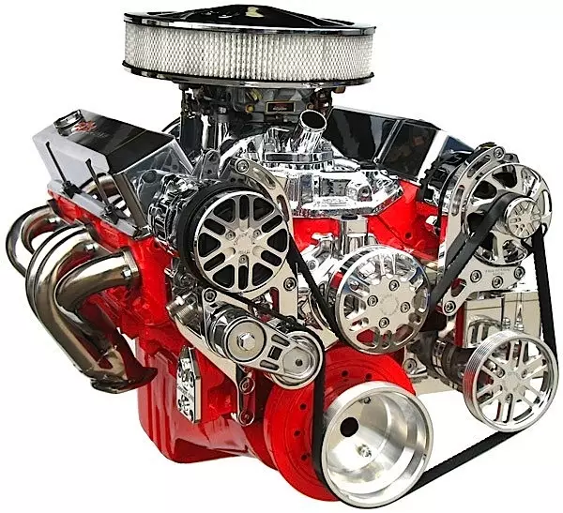
Belt Drives
General Definition
Belt drives work by transmitting power through the friction or grip between a belt and pulleys, which are the rotating components connected to the shafts of the machines.
The belt loops around the pulleys, and as the pulley rotates, it moves the belt, transmitting power from one shaft to another.

Slide 3
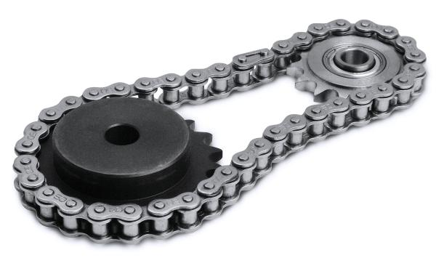
Advantages of Belt drives
Economical to install and maintain.
Generally, require no lubrication. Some hybrid systems might although require lubrication (for instance: chain-belt drives).
Can be adjusted for a wide range of applications and operating conditions.
Pulleys are less expensive than chain-sprockets.
Belt drives also have a longer life than chain-sprocket system.

Slide 4
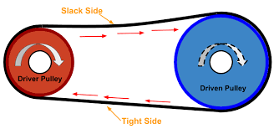
Power Transmission with Belt drives
Let’s quickly revisit some fundamentals:
Torque: Cross product of the moment arm and force
What is moment arm?
Friction force
Angular velocity: Rate of change of angular displacement (V = rω)
How is it related to RPM?
Tension/Tight side: The side of the belt that goes into driver element.
Slack side: The side of the belt that goes away from the driver element.

Slide 5
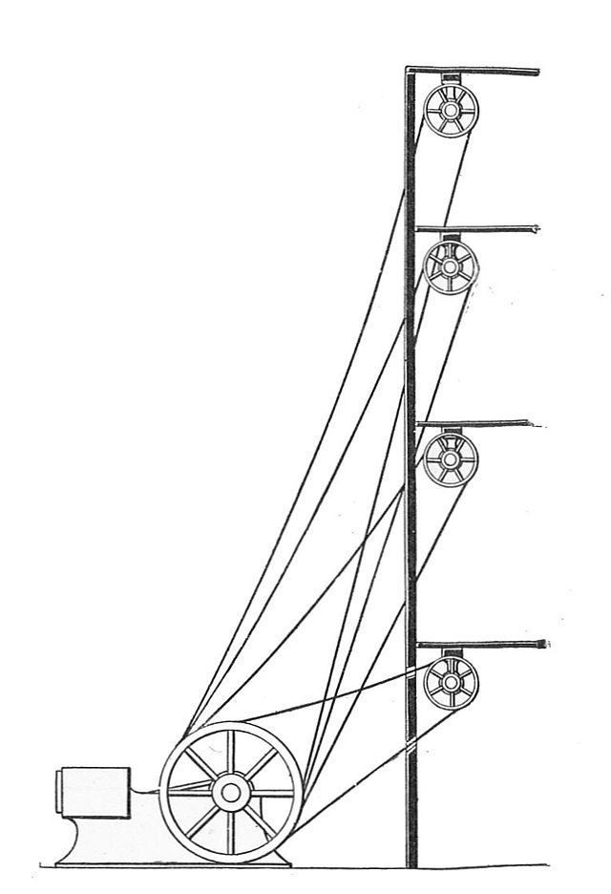
Types of Belts
Rope belts: Typically made from ropes or braided materials like cotton, hemp, or synthetic fibers.
Rope belts were widely used in older mechanical systems for transmitting power between pulleys over long distances.
They have a round cross-section, which helps them fit into specially designed pulleys with grooves (called grooved pulleys).
What do you think a design of a pulley should ensure?
Rope belts had higher wear and lower efficiency compared to modern belt designs, they were less efficient.

Slide 6
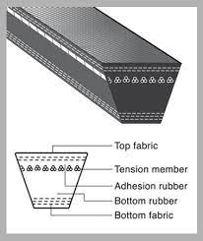
Types of Belts
Flat belts: They are one of the oldest belts alongside the traditional ropes,
however, have a rectangular cross-section in contrast.
High tension is required for power transmission.
What is a tension force?
They are extremely flexible and cheap to manufacture.
2. V-belts: They are ‘V’ shaped in cross-section, which matches the ‘V’ shape of pulleys. This design allows for the belt to sit tightly in the pulley groove.

Slide 7
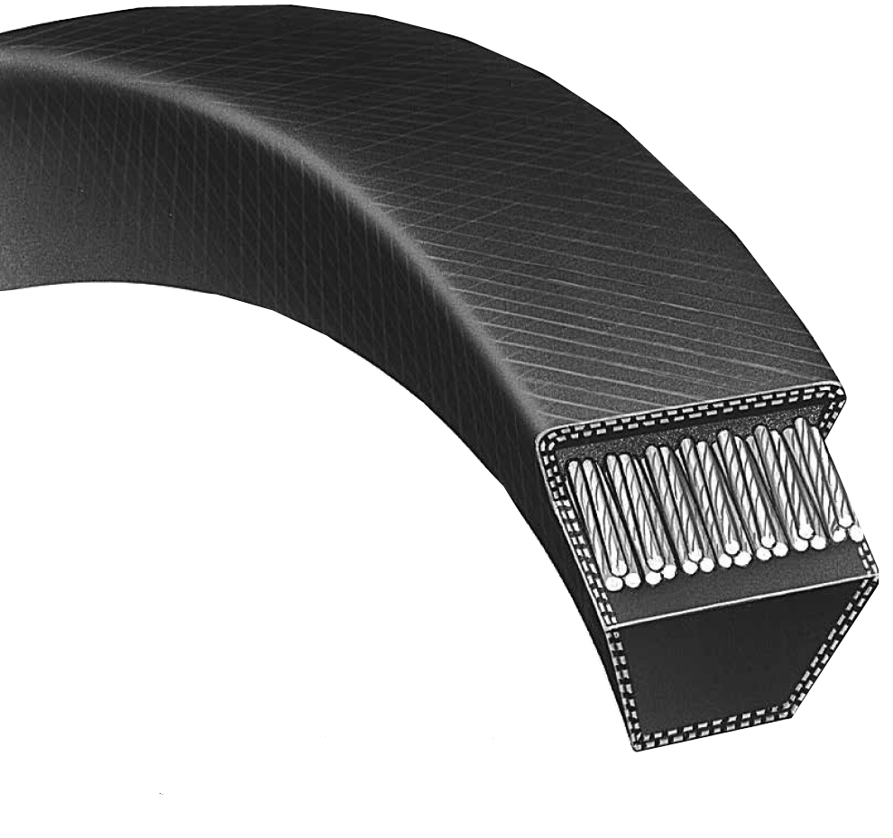
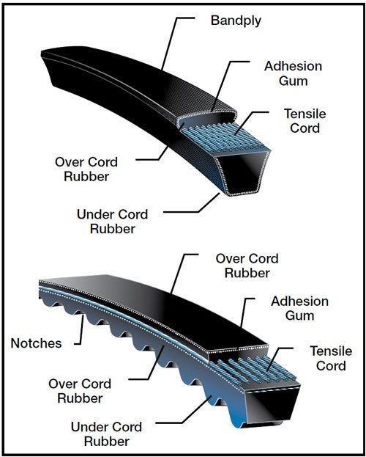
V Belts

Slide 8
V Belts
The difference between the tension forces is called effective tension.
T_{e} = T₁-T₂
The ratio between the tensions is called tension ratio.
T_{r} = T₁/T₂
The coefficient of friction is expressed as:
$μ= \frac{ln\frac{T_{1}}{T_{2}}}{φ}$ ; where, $φ$ is the wrap angle.
What is the friction force here? Revisit your concept of linear friction force …

Slide 9
V Belts

Slide 10
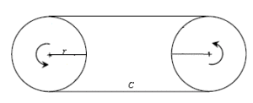
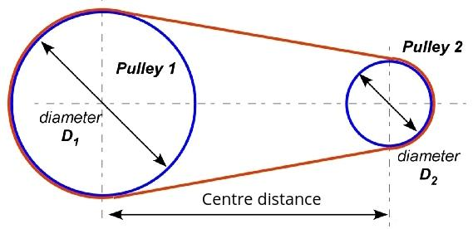
Length of V Belts
Note that the two pulleys are of the same diameter:
L = 2C + 2$πr$ ; where ‘C’ is the center-to-center distance and ‘r’ is the radius.
Now, the diameters are different (D₁ > D₂).
$L=2C+ π \left[\frac{D_{1}+ D_{2}}{2}\right]+ \frac{{(D_{2}−D_{1})}^{2}}{4C}$

Slide 11
Variable Speed Belts
General Mechanism:
Variable speed belt drive is a special class of two-sheaves (conical in shape) drive, that can vary the speed of the driven sheave.
The belt moves across different sections of the pulley through the use of variable-diameter pulleys, which allow smooth speed adjustments by changing the effective diameter at which the belt contacts the pulley.
An animation might help, right?

Slide 12
Variable Speed Belts
General Mechanism (continued):
When the sheaves (on the driver) move closer together, the belt rides higher on the pulley, increasing the effective diameter, which transmits more ‘speed’ to the driven component ----- concept of gear ratio?
The gear ratio depends on the effective diameters of the driver and driven pulleys at any given moment. It is calculated by dividing the diameter of the driven pulley by the diameter of the driver pulley.
$GR= \frac{Dia. of the driven pulley}{Dia. of the driver pully}$
How does the speed change? How about torque?
N₁D₁ = N₂D₂

Slide 13
Variable Speed Belts
In summary, as the pulley width changes due to movement of a sidewall, i.e. a sheave, the belt rides either shallower or deeper in the groove. This allows infinite possibilities of the speed ratio.
With a single adjustable pulley, speed ratio changes of 20% to 40% are typical.
If both, the driver and driven pulleys are adjustable, speed ratio changes of 40% to 100% are possible.
Why are we talking about changes in speed ratio as a function of pulley being adjustable?
The Continuously Variable Transmission (CVT) somehow uses the same concept, where the effective diameter of the pulleys are changed for power transmission.

Slide 14
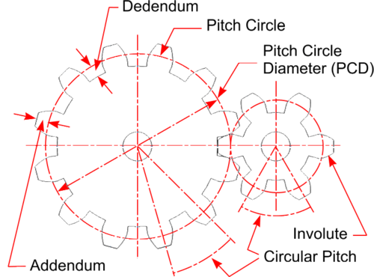
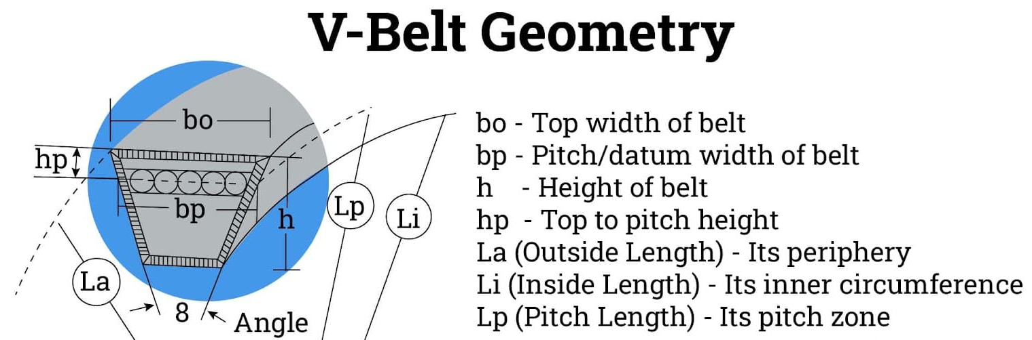
Nomenclature of V belts
First, we need to learn some important definitions:
Pitch circle
An imaginary circle that intersects the teeth of a gear at the actual points where the teeth mesh with another gear
Pitch
Distance between two identical points of adjacent cogs or teeth.
Dedendum
Depth of the tooth between the pitch circle and the minor dia.
Addendum
The height of the tooth above the pitch circle

Slide 15
Nomenclature of V belts
The general nomenclature includes information about belt's size, type, and design. This helps the users identify the belt's cross-sectional shape, width, and length.
The first letter or set of letters indicates the belt’s cross-sectional shape and profile. Common examples include:
A, B, C, D: Standard V-belts with different cross-sectional sizes.
3V, 5V, 8V: Narrow V-belts that are more compact but offer greater strength.
AX, BX, CX: Cogged V-belts, which have notches for better flexibility.
The letters correspond to a specific width and height for the belt. For example:
A-section has a top width of 1/2 inch and height of 5/16 inch.
B-section has a top width of 5/8 inch and height of 13/32 inch.

Slide 16
Nomenclature of V belts (Cont.)
The number following the belt type indicates the length of the belt in inches (for imperial belts) or millimeters (for metric belts).
What will be the outside length of a BX90 V-belt?
Section | Number to add to get outer diameter | Section | Number to multiply with ribs to get width
A / AX | 2” | K | 0.140”
B / BX | 3” | L | 0.185”
C | 4” | M | 0.370”
D | 5”
E | 6”

