Slide 1
Mechanical Power Transmission
MMET 301
Syed Samar Abbas

Slide 2
Clutches and Brakes
Clutches
The literal meaning is to grasp or seize something.
Concept of the Engine transmission system – Lets see an animation over Youtube!
Device that is used to engage or disengage driver shaft to a driven shaft in general, and/or to engage or disengage the engine from transmission in specific.
Brakes
The main idea involves stopping/holding rotary motion.
Primary use is to stop a shaft from rotating and can be used to hold it in that position, preventing it from rotating for a while.

Slide 3
Clutches and Brakes
We just discussed that clutch is a device that is used to engage or disengage driver shaft to a driven shaft in general, and/or to engage or disengage the engine from transmission in specific – what physical ‘quantity’ do you think it interrupts?
Let’s have a look at an animation to further understand how do clutches work!
Clutches and brakes are different components … Why are we studying them together?
Turns out that they are very related and under some mounting conditions, may function in a similar fashion!

Slide 4
Clutches and Brakes
Applications include wide range of pumps, fans, conveyers in industries and cars .
For both clutches and brakes, the transmission of torque can take place via:
Frictional forces
Electromagnetic flux
Mechanical lockup
Method of actuation could be another categorization – mechanical, electromagnetic, pneumatic or hydraulic.
The selection criterion primarily includes:
Torque.
Response time.
Availability of space and method of actuation .
Thermal capacity and operating requirements.

Slide 5
Clutches and Brakes
An example of selection criterion

Slide 6
Clutches and Brakes
General Friction Types:
Use the force of friction to transmit torque.
Most commonly used type of clutches and brakes for general starting and stopping.
Can have any actuation method: pneumatic, hydraulic, electric or mechanical.
May have single, dual or multiple face engagements.
Are available for a shaft or flange mounting.
Friction type clutch:
Engages two rotating shafts by using frictional contact between surfaces, allowing the shafts to either spin together or separately.
Could be further classified into single-plate, multiple-plate or cone clutches.
b) Friction type brakes:
Use the friction force between two surfaces two surfaces and dissipate the energy of the moving parts (i.e. the kinetic energy) as heat (for example: Disc, Drum etc.)

Slide 7
Clutches and Brakes
Single Interface Clutch/Brake
Has single interface on both, clutch and brake ends.
Multiple Interface Clutch/Brake
Clutch faces are stacked –
Low ventilation and lower duty cycle.
Use is specific to industrial conditions and/or operation requirements.
For instance, corrosion-resistant units might be required in some cases.

Slide 8
Some important definitions
1. Overrunning: In this function, the clutch allows the driven shaft to rotate faster than the driving shaft. It means the clutch engages when torque needs to be transmitted in one direction but disengages or "freewheels" when the driven component spins faster or in the opposite direction.
Applications: (a) Starter motors in vehicles, where the engine starts and spins faster than the starter, disengaging the clutch to avoid damage and (b) Conveyor belts, where the motor can be stopped while the belt continues to run under its own inertia.
2. Backstopping: Backstopping clutches only permit rotation in one direction and prevent any reverse rotation. They automatically lock in place if the driven component tries to move in the reverse direction.
Applications: (a) Elevators or inclined conveyors to prevent them from rolling backward under load and (b) Heavy machinery where reverse motion could cause safety risks or mechanical failure.
3. Indexing: Indexing is when the clutch engages at regular intervals to create a stepwise or incremental movement of the driven component. This function is useful when converting continuous rotation into discrete, controlled steps.
Applications: (a) Printing presses and packaging machines, where precise, repeated movements are necessary and (b) Conveyor systems where items need to be moved and stopped at specific points for further processing.

Slide 9
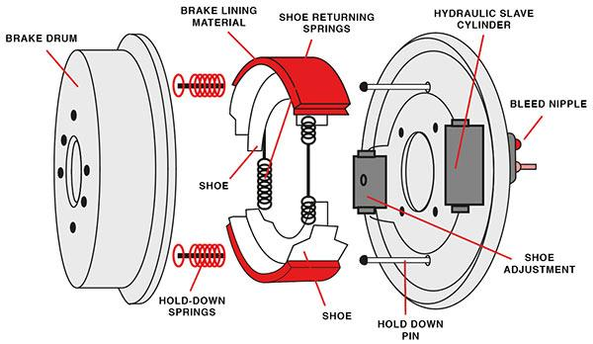
Brakes
Caliper brake
It functions by using a pair of calipers to squeeze brake pads against the sides of a rotating wheel or disc, creating friction and slowing down or stopping the vehicle.
Rim brakes: The calipers squeeze the brake pads against the rim of the wheel.
Disc brakes: The caliper clamps brake pads onto a metal disc (rotor) attached to the wheel.
Drum/Shoe brake
The brake shoes are pressed against the surface of a rotating drum, attached to a wheel, thereby creating friction.
Expanding types – shoes move outward to engage the inside surface of drum.
Contracting types – shoes move inward to engage the outside surface of drum.

Slide 10
Brakes
Electromagnetic/Eddy current based:
Also referred as the electric retarder – it is based on creation of eddy currents within a metal disc rotating between two electromagnets.
If the electromagnet is not energized > the metal disc can rotate freely.
If the electromagnet is energized > the rotation of metal disc is retarded.
Eddy current is ‘induced’ in the metal.
The circulation of eddy current opposes the motion of the metal.
Heat is produced.
Terms to look for: Electromagnet? Magnetic field? Electric field?
In-class activity.

Slide 11
Regenerative Braking
For both, friction-type and electromagnetic-type brakes, we learned that the kinetic energy of the moving part is converted to heat when the brakes are applied.
This generated heat must be dissipated, or in other words, the kinetic energy must be fully dissipated (in simple words, wasted).
When the driver presses the brake pedal or lifts off the accelerator, the regenerative braking system activates.
Instead of using friction to slow down the vehicle, the system converts the vehicle's kinetic energy into electrical energy (motor becomes a generator).
Regenerative braking alone may not provide enough stopping power. Traditional friction brakes are still necessary for such situations.

Slide 12
Actuation Methods
1. Mechanical Actuation: This refers to systems where mechanical forces (such as levers, gears, cams, and other mechanical linkages) directly cause motion or force to perform work.
Example: In some cars with manual transmission system, a clutch pedal is mechanically linked to the clutch assembly by a cable or rod. Pressing the pedal releases the clutch plate, enabling gear shifting.
2. Electric Actuation: Electrical actuators use electric energy to produce mechanical movement, typically through electric motors or solenoids.
Example: Electric window openers in cars use electric motors to raise or lower the window. Similarly, electric actuators control various valves and dampers in industrial systems.
3. Electromagnetic Actuation: This system uses electromagnetic forces to produce motion, often utilizing electromagnets, which can generate a magnetic field when energized by an electric current.
Example: A solenoid valve, common in hydraulic and pneumatic systems, is an example where a magnetic field generated by an electric current moves a plunger to open or close a valve.
4. Pneumatic Actuation: Pneumatic actuators use compressed air to generate motion. Air pressure forces a piston or diaphragm to move, resulting in mechanical movement.
Example: Pneumatic cylinders in automated manufacturing systems are used for pushing, pulling, and gripping actions, controlled by compressed air systems.

Slide 13
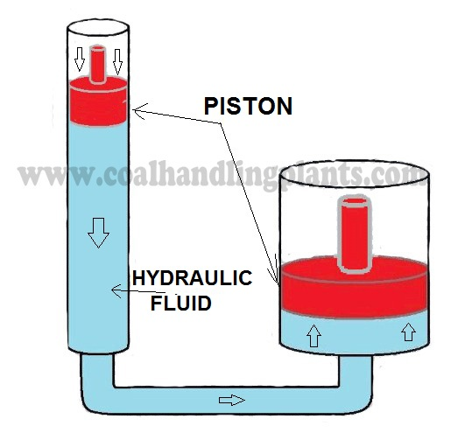
Actuation Methods
5. Hydraulic Actuation: Hydraulic actuators rely on pressurized fluids to create mechanical movement. They are capable of producing large forces due to the incompressibility of liquids.
Example: Hydraulic brakes in vehicles or hydraulic lifts used in construction machinery are common examples where fluid pressure is converted into movement.
6. Self-actuating Clutches: These are clutches that engage or disengage automatically based on certain operational conditions (e.g., speed, torque). They do not require external input or control mechanisms to operate.
Example: A centrifugal clutch is a type of self-actuating clutch found in small motorized devices like chainsaws or go-karts. It engages as the engine speed increases and disengages when the speed drops.

