Slide 1
Mechanical Power Transmission
MMET 301
Syed Samar Abbas

Slide 2
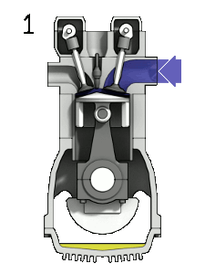
Prime Movers
Any machine/device which converts variable forms of energy into mechanical energy.
One of the most common example is an Internal Combustion Engine.
Electric motors: How do they work?
Turbines (Water, wind and gaseous resources).
How do you think the jet engines work?

Slide 3
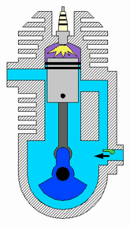
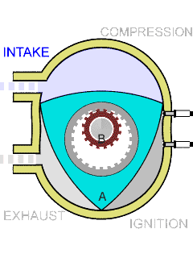
Prime Movers (Combustion-based)
Internal and External Combustion. Difference?
Types of Internal Combustion Engines : Reciprocating and Rotary
Gasoline or Spark Ignition (SI)
Four stroke versus Two stroke
(b) Diesel or Compression Ignition (CI)
(c) Wankel Engine

Slide 4
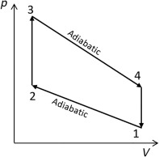
Prime Movers (Combustion-based)
Reciprocating Internal Combustion Engines – Thermodynamics
Based on the Otto Cycle:
The main processes occurring in an Otto cycle are as follows:
• Isentropic (adiabatic) compression
• Constant volume heat addition
• Isentropic (adiabatic) expansion
• Constant volume heat rejection

Slide 5
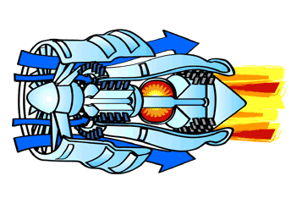
Prime Movers (Combustion-based)
Gas turbines
Widely used in jet engines
What do you think, are they Internal Combustion Engines?

Slide 6
Prime Movers (Combustion-based)
Prime Movers
(that use combustion)
Internal Combustion
Two-Stroke
External Combustion
Gasoline
(Spark Ignition)
Four-Stroke
Reciprocating
Steam Turbine
(commonly based on Rankine Cycle)
Two-Stroke
Diesel
(Compression Ignition)
Four-Stroke
Wankel
Engine
Rotary
Stirling Engine
(based on Stirling Cycle)
Gas Turbine
(Jet Engines)

Slide 7
Prime Movers (Combustion-based)
Four Stroke
Two Stroke
Reciprocating
Rotary

Slide 8
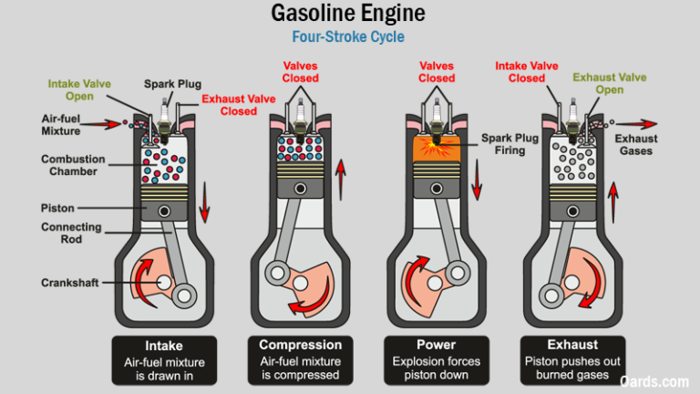
Prime Movers (Combustion-based)
Further details: Four Stroke
Four Stroke Spark Ignition (Gasoline) Engine: 01 power stroke in 02 revolutions of shaft:

Slide 9
Prime Movers (Combustion-based)
Further details: Four Stroke
1. Intake Stroke: The intake valve opens, and the piston moves down in the cylinder. This allows the air-fuel mixture to enter the combustion chamber.
2. Compression Stroke: The intake valve closes, and the piston moves back up, compressing the air-fuel mixture. Compression increases the temperature and pressure inside the cylinder, making the mixture more volatile.
3.Power Stroke (Combustion Stroke):When the piston reaches the top, a spark plug (in gasoline engines) ignites the compressed air-fuel mixture. The explosion forces the piston back down, turning the crankshaft and producing power to drive the vehicle.
4. Exhaust Stroke: The exhaust valve opens, and the piston moves back up to push the burned gases out of the combustion chamber. The cycle then repeats.

Slide 10
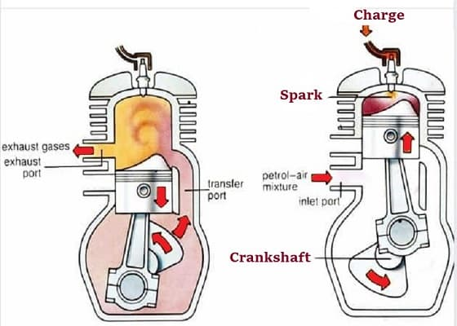
Prime Movers (Combustion-based)
Further details: Two Stroke
Two Stroke Spark Ignition (Gasoline) Engine: 02 power strokes in 02 revolutions of shaft:

Slide 11
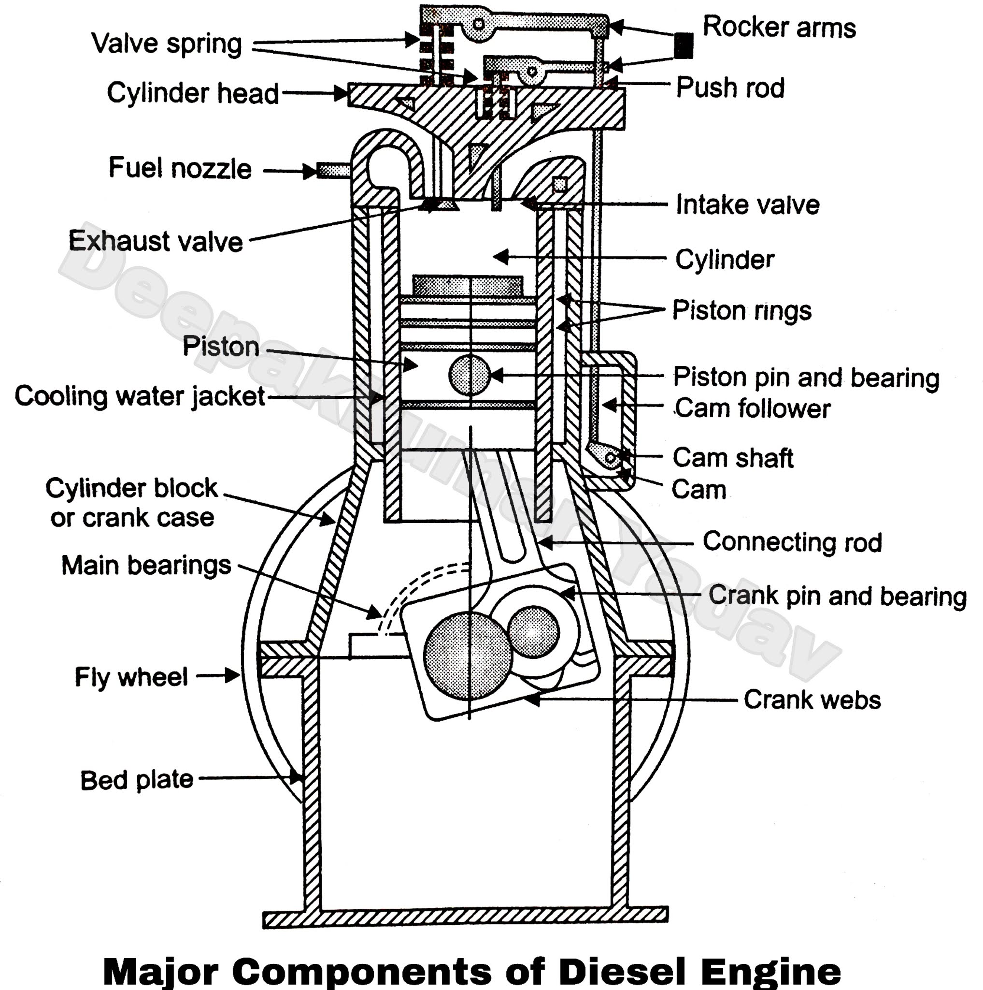
Prime Movers (Combustion-based)
Compression Ignition (Diesel Engines)
In general, a diesel engine works by using a piston to compress air to increase the temperature in the cylinder and then injecting diesel fuel into this cylinder. When the fuel comes into contact with the high temperature, it ignites, creating energy that drives the piston down transferring energy to the crankshaft and through the powertrain.

Slide 12
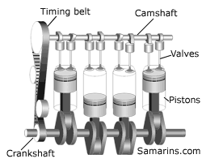
Prime Movers (Combustion-based)
- Gasoline engines: Use carburetors or fuel injectors to mix air and fuel.
- Diesel engines: Rely on direct fuel injection, eliminating the need for a carburetor.

Slide 13
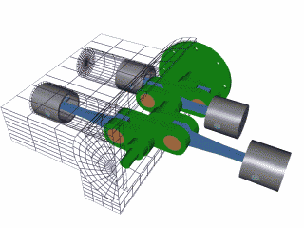
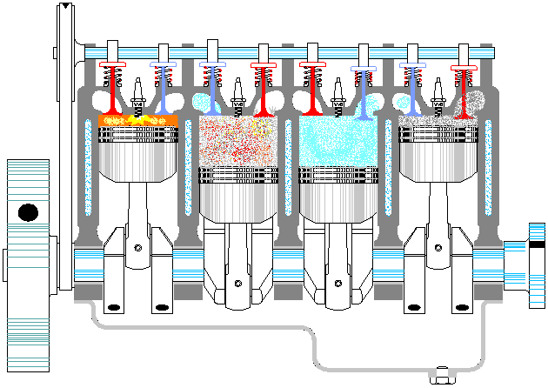
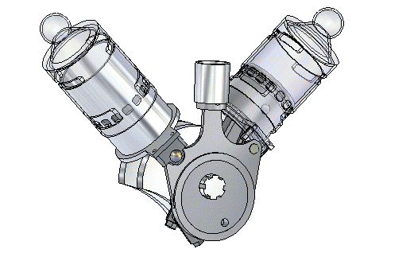
Prime Movers (Combustion-based)
Arrangements

Slide 14
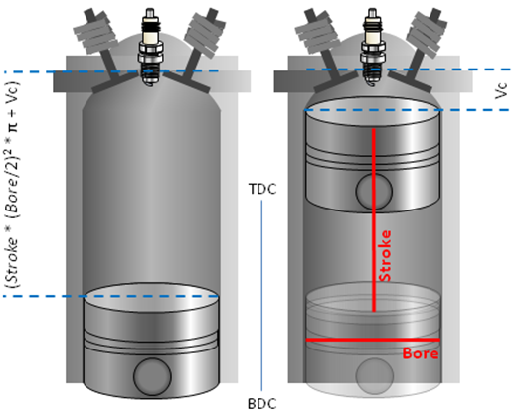
Prime Movers (Combustion-based)
Compression Ratio (CR)
b= inside cylinder diameter/ the diameter of the piston
s= piston swept area through rotation of crankshaft by 180 degrees (length)
$V_{c}$= clearance volume (Minimum volume of the space at the end of the compression stroke, when the piston is at the top dead center).
$CR=\frac{\frac{π}{4}b^{2}s+V_{c}}{V_{c}}$
For example:
Motor bike 14:1
Diesel engine 22:1

